Slide 1
Welcome to Global AI Bootcamp Kuala Lumpur
Organized by Microsoft MVPs and Student Ambassdors

Slide 3
Agenda of the Bootcamp
10:30 AM - 11:00 AM: Deep Dive Demo of Azure Open AI by Ashish Sharma & Muhammad Suzaril Shah
11:00 AM - 11:30 AM: Unlocking Machine Learning with ML.NET for Business Applications by Chan Ming Man
11:30 AM - 12:30 PM: Tech Talk on Microsoft Azure AI by Justin, Microsoft Cloud Solution Architect
12:30 PM - 1:00 PM: Global AI Mastermind Challenge
1:00 PM - 2:00 PM: Engage in Q&A and Networking Session with Industry Experts!

Slide 4
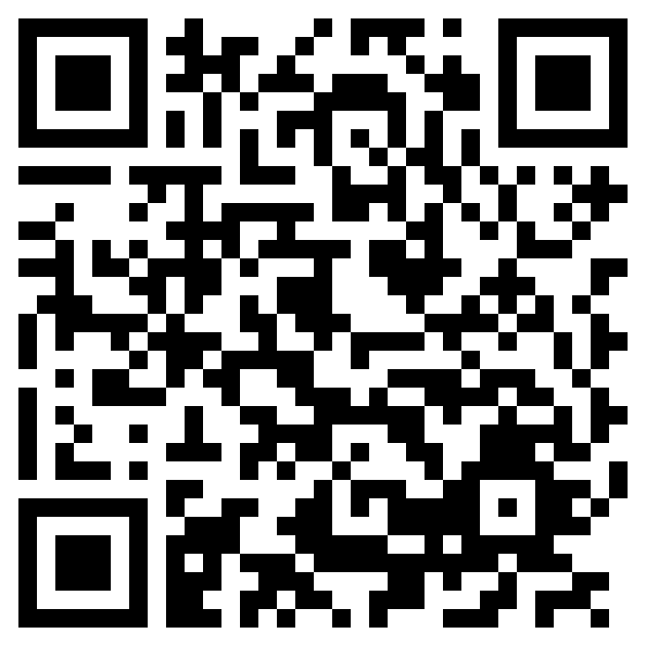


Global AI Bootcamp Kuala Lumpur
Share on LinkedIn
AI Learning Sessions
Networking
https://globalai.community/bootcamp/malaysia-kuala-lumpur/badge/

Slide 5
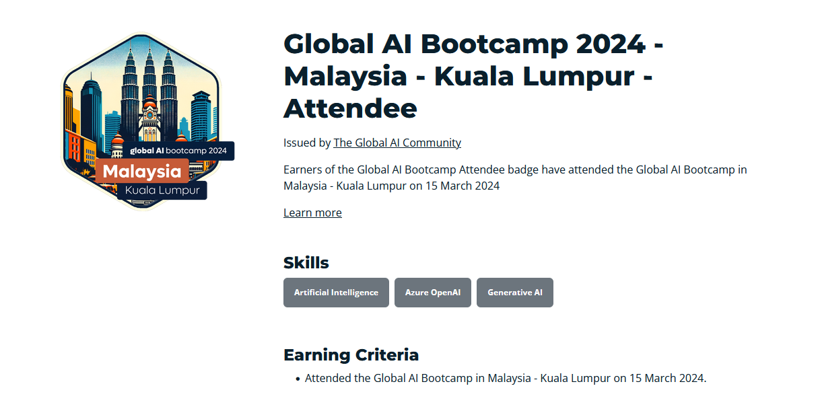

Slide 6
EVENTBRITE: AZURE COMMUNITY MALAYSIA Link: https://www.eventbrite.sg/o/azure-community-malaysia-75754836673

Slide 7
NEXT EVENT: GLOBAL AZURE BOOTCAMP APRIL 2024

Slide 8
Thank you

